Slide 1
Medicinal plants containing flavonoids.

Slide 2
Flavonoids
The term flavonoid describes all polyphenolic plant constituents that have a carbon skeleton. All of the approximately 4000 flavonoids that have been identified possess this same basic structural makeup. They are nearly ubiquitous secondary metabolites found especially in leafs, fruits & flowers. The are water soluble and occur both in free state and as glycosides.

Slide 3
Their major role in plants is to function as growth regulators, and protect the plant from UV radiation by scavenging free radicals produced by the photosynthetic electron transport system. The also act as pigments, imparting colour to flowers & fruits.

Slide 4
Major Flavonoids Classes Include:
Flavonols (Quercitin)
Flavones (Apigenin)
Flavonones (Naringin)
Isoflavones (Genistein)
Catechins
Anthocyanidins/Proanthocyanidins (Aka. Condensed tannins)

Slide 5
In the body they have a wide range of actions and many medicinal uses. Being potent antioxidants, they have been referred to as “nature’s biological response modifiers” or Redox Regulators, since they modify the body’s reaction to compounds such as allergens, viruses and carcinogens as evidenced by their anti-inflammatory, anti-allergic, antiviral and anticancer properties. Additionally they will strengthen vascular capillaries to prevent leakage of body fluids into surrounding tissues, and some will have phytoestrogenic, and liver-protective activity.

Slide 6
In summary the major actions of flavonoids include:
Antioxidant or Redox regulators, permitting resonance stabilization and rending potentially damaging molecules relatively unreactive
Smooth muscle relaxation (antispasmodics & hypotensives)
Reduced platelet aggregation & blood vessel protectants
Improved hypoxic tolerance

Slide 7
Enhanced neural transmission & Neuro-protective effects
Inhibition of mast cell lysis
Reduced capillary fragility via ability to crosslink collagen fibers
Increased intra-cellular vitamin C
Reduced allergic responses
Reduction of inflammatory leukotrienes
Bind metal ions

Slide 8
Pharmacology of Flavonoids
Inhibit the reduction of dehydroascorbic acid via glutathione by acting as H+ donors.
Inhibit catechol-O-methyltransferase → increased availability of catecholamines
Stimulate proline hydroxylase → formation of cross links between collagen fibers reinforces tensile strength of connective tissue and cell structures
Are synergists for Vitamin C, and will increase the amount of available in tissues by preventing it’s breakdown and up regulating it’s absorption

Slide 9
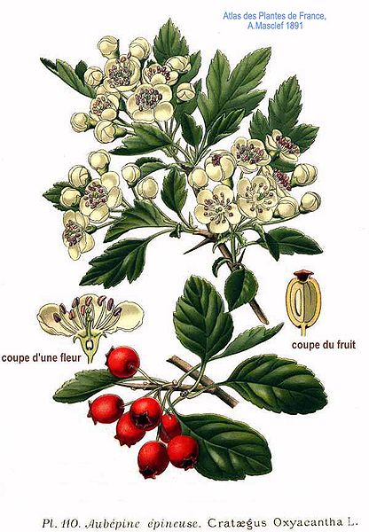
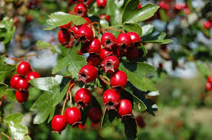
Crataegus oxycantha
Common name: Hawthorne
Family: Rosaceae
Parts used: Flora, leaves, and berries

Slide 10
Constituents:
Oligomeric procyanidins, flavonoids (kaempferol, quercetin, apigenin, luteolin, rutin), amines, anthocyanidins
Medical actions:
CNS sedative, antioxidant, adaptogen, cardiac trophorestorative, cardiotonic, hypotension, coronary vasodilator, peripheral vasodilator, anti-arrhythmic, diuretic, collagen stabilizing, reduces myocardial oxygen demand, protects against myocardial damage.

Slide 11
Medical Indications:
One of the best tonic remedies for the whole of the heart and circulatory system. Acts in a normalizing way upon the heart by either stimulating or depressing its activity based upon the need. As a long-term treatment may be used safely in heart failure (cardiac insufficiency) and weakness.

Slide 12
May similarly be used in cases of palpitations, arrhythmia and valvular insufficiency. As a tonic for the circulatory system has an important use in the treatment of hypertension, atherosclerosis, and angina. Will play a role in any treatment of vessel problems including varicose veins or even ulcers. Can be used for arthritis, fractures, and osteoporosis.

Slide 13
Pharmacology:
Procyanidins are antioxidant, improve coronary circulation and have negative chronotropic and positive inotropic action on the heart.
Flavonoids are negative chronotropic, positive inotropic, relax and dilate arteries and are highly antioxidant. Rutin specifically, improves integrity of blood vessels and capillaries.
Anthocyanidins help stabilize collagen in cartilage and bone.

Slide 14
Pharmacy:
Dried/fresh leaf, flower or fruit: 1.5 – 3.5 g dry (3x if fresh) infusion or decoction. Tincture (1:5, 45%), 1-2ml TID. There is no restriction on the long-term use of Crataegus. Rather, Crataegus should be used at least 2 months for treatment of heart conditions.

Slide 15
Contraindications: None known.
Toxicity: No adverse effects expected within recommended doses.
Interactions: May help reduce toxicity of cardiac glycosides, hypertensive medications and CNS depressants. Interaction with Digitalis has not been confirmed.

Slide 16
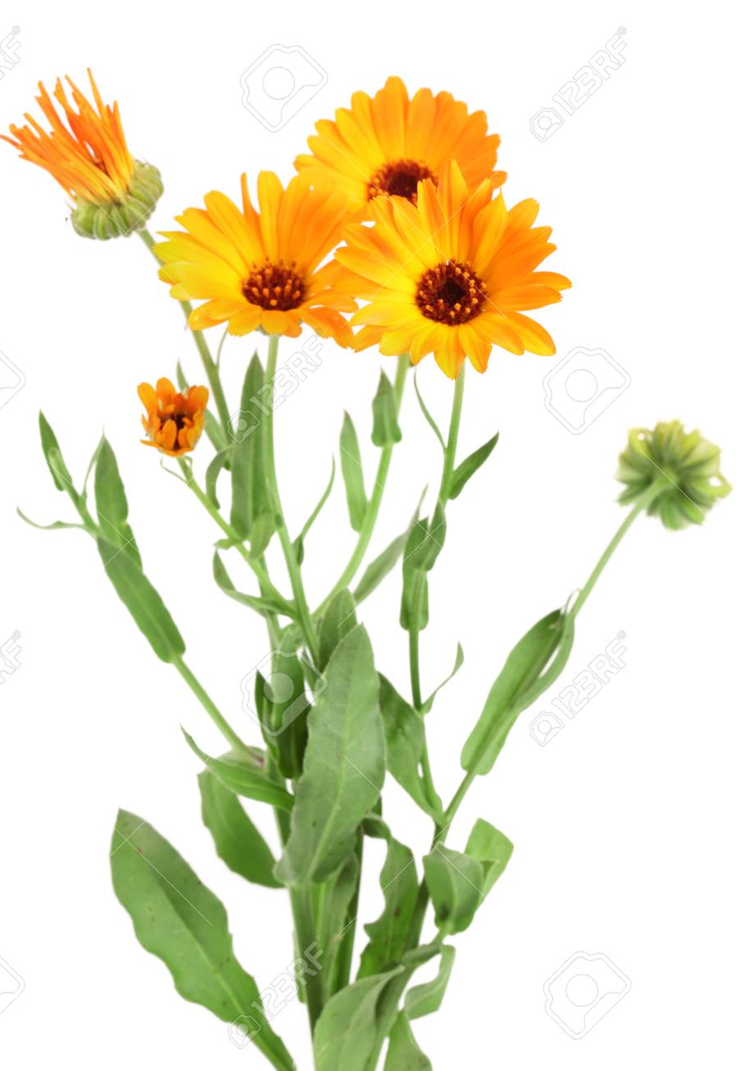
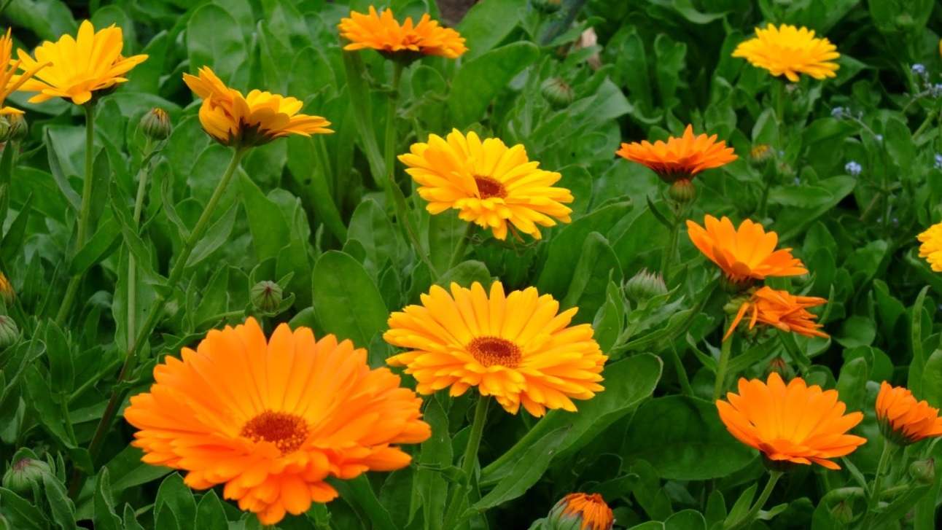
Calendula officinalis
Common name: Marigold, Calendula
Family: Asteraceae
Parts Used: Flower heads & Ray florets

Slide 17
Constituents:
Triterpenoid & Steroidal saponins (yields oleanolic acid)
Flavonoids
Mucilage & Polysaccharides
Bitter resin (calendulin & caledin)
Volatile oils
Xanthophyls & Carotenoids
Sterols (beta-sitosterol) & Fatty acids (myristic and palmitic esters)

Slide 18
Medicinal actions:
Anti-inflammatory
Antimicrobial
Antispasmodic
Emmenagogue
Immunostimulant
Lymphatic
Vulnerary (Demulcent & Emollient)

Slide 19
Medicinal uses:
Various preparations (e.g. infusions, tinctures, fluid extracts) have a long use in folk medicine, particularly in the topical application to wounds, ulcers, eczema, burns, etc. and is considered one of the best herbs for treating local skin problems in first aid treatment with a lotion, poultice or compress.
As a lymphatic, used to stimulate the drainage of enlarged, inflamed lymph nodes and is specific for the lymphatics in the breast and pelvic tissues.
As an emmenagogue it has a reputation of helping delayed menstruation and painful periods.

Slide 20
Pharmacology:
Saponins have mild phytoestrogenic activity, decrease tissue swelling, increase capillary perfusion of tissue and along with flavonoids decrease inflammation.
Immuno-stimulating properties are derived from the polysaccharides and volatile oil.
Anti-fungal properties are only found in a tincture. It is the resin, myristic & palmitic esters which are anti-fungal.
Vulnerary actions are due to the xanthophyls (which stimulate granulation tissue), mucilage and volatile oils.

Slide 21
Pharmacy:
Infusion: 1-4 g/cup TID
Tincture: (1:2, 60%), 1.5-4.5 ml QD, or 10-30 ml weekly.
Topicals: washes, creams, ointments, oils, poultices, suppositories, and fresh plant succus.
Toxicity:
An extremely safe herb without documented side effects. There is a low but potential likelihood for allergic sensitivity.

Slide 22
Contraindications:
Avoid internally in pregnancy due to potential emmenagogue effects and in known Asteraceae allergy.
Interactions:
None known.

Slide 23
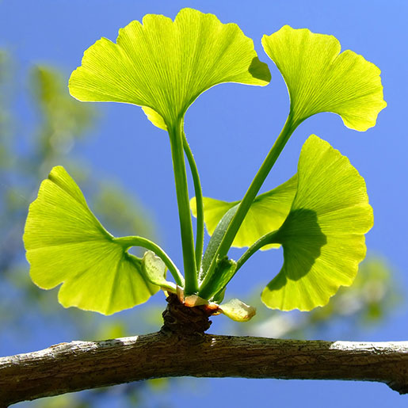
Gingko biloba
Common name: Gingko, Maidenhair tree
Family: Gingkoaceae
Part used: Leaf

Slide 24
Constituents:
Flavonoids (quercetin, kaempferol), terpenoids (bilobilides, ginkgolides), bioflavonoids, ginkgolic acid (toxic), proanthocyanidins, amino acids, benzoic acid, sugars, waxes, lactones, sitosterol

Slide 25
Medicinal actions:
Energy enhancer, cognitive enhancer, neuroprotective, relaxant, anti-inflammatory, astringent, anti-allergenic, anti-asthmatic, brain flow blood enhancer, circulatory stimulant & tonic, peripheral vasodilator, anti-platelet, antioxidant, bitter, nutritive, uterine stimulant, tissue perfusion enhancing, antispasmodic, anti-thrombotic.

Slide 26
Inhibit platelet aggregation and adhesion
Prevent hemolysis
Inhibit lipid peroxidation (antioxidant)
Regulate arteriolar and venular tone (via metabolic and neuro-mediated pathways)
Increase cerebral blood flow
Vasodilate medium and small arteries (secondarily capillaries and venules
Suppress cerebral vasospasm
Stabilize capillary permeability
Enhance tissue O2 and glucose uptake and use

Slide 27
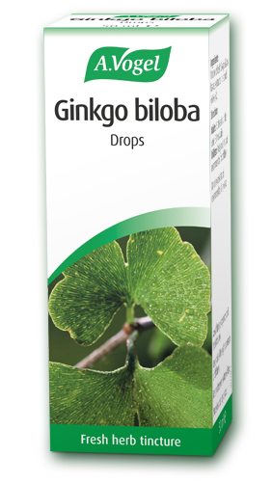
Increase hypoxia tolerance
Inhibit cytotoxic brain edema
Promote Ach receptors in hippocampus
Reverses loss of serotonin receptors in aging
Increase turnover of cerebral neuromediators
Elevate neuronal info. transmission rate
Decrease cerebral blood flow and thus indirectly anti-depressant

Slide 28
Medicinal uses:
Improves brain metabolism of glucose and oxygen. Promotes blood flow to the brain to improve memory and concentration, cognitive & brain function. In managing Alzheimer’s can serve to enhance cerebral circulation, promote memory and cognition, act as an anti-coagulant and anti-oxidant. It’s strong antioxidant effects can increase energy and be used in allergic inflammatory reactions. Useful in peripheral vascular disease and restricted blood flow for any reason. Can inhibit platelet aggregation, relaxes blood vessels and improves their tone, and can be use topically as an anti-inflammatory.

Slide 29
Pharmacy:
Infusion: 1 tbsp/cup, infuse 5 min, TID. Capsules: 250mg, QD-BID. Tincture: (1:5,25%), 2-4ml TID. Note: May take 6 weeks to see effects. Pause 6 weeks every 6 months.
Pharmacology:
Flavonoids are antioxidant and protect blood vessels, brain and heart from free radical damage. Increase oxygen and glucose utilization & blood flow, therefore tissue oxygenation and nutriton.
Terpenoids, ginkgolides may be responsible for neuroprotective effects.

Slide 30
Contraindications: Caution when using Ginkgo with patients on anticoagulant or antiplatelet medication such as warfarin and aspirin. Cases of excessive bleeding may also be contraindicated.
Toxicity: Gingko standardized extract use has very low risk. Use of the raw herb, however, can cause complaints. Side effects from the consumption of the leaf: GI discomfort, dizziness; from the fruit/nut: erythema, edema, severe GI irritation.
Interactions: With blood thinners, thiazide diuretics.

Slide 31
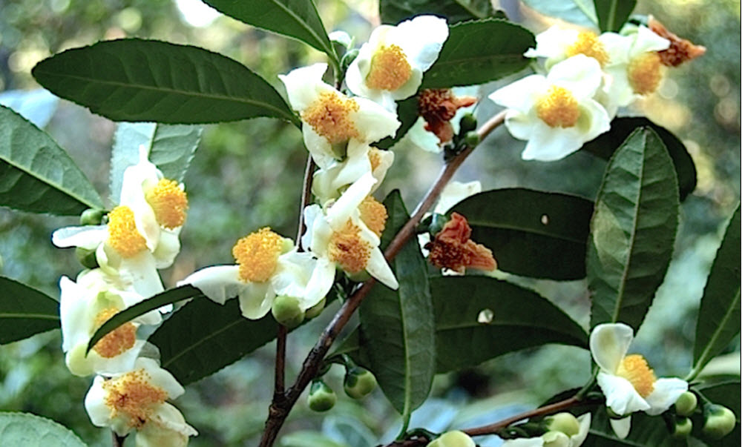
Camellia sinensis
Common name: Green or Black tea
Family: Theaceae
Part used: Leave & buds (black tea uses fermented dried leaves)

Slide 32
Constituents:
Xanthine alkaloids (caffeine, theobromine, theophylline), polyphenols, Flavonoids, tannins, nutrients, oxalate
Actions:
Nervous system stimulant, antioxidant, diuretic, astringent, anti-bacterial, cardiotonic

Slide 33
Medical uses:
It should be noted that green tea has higher therapeutic properties than black tea. As a nervous system stimulant both teas can be used for fatigue and headaches. Green tea especially has been found to have anti-cancer & cancer preventative effects, specifically reducing the carcinogenic effects of female hormones.
Its immune and inflammatory modulating activity can also be beneficial in fever, cough, colds/flu, infections and edema.
Cardiotonic effects give it use in the prevention of arterioslcerosis, high cholesterol and various heart conditions.

Slide 34
Pharmacy: Powder: 250mg, 2 caps TID with meals. Infusion: 2 tsp/cup, infuse 3-5 min, TID.
Contraindications: Consider avoiding during pregnancy if sensitive to caffeine.
Toxicity: Avoid adverse effects by taking away from ginseng or other stimulants. Caffeine may cause insomnia, palpitations, nervousness and irritability in some patients.

Slide 35
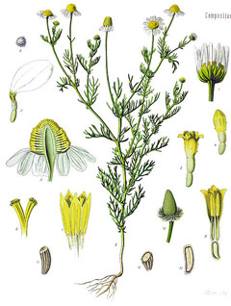
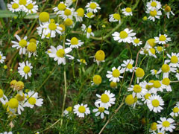
Matricaria recutita
Common name: Chamomille, German chamomille
Family: Asteraceae
Parts used: Flowers

Slide 36
Constituents:
Volatile oil (azulene, chamazulene & matricin), sesquiterpenes lactones, coumarins (umbelliferone), salicylic acid, choline, fatty acids, mucopolysaccharides, flavonoids (apigenin, luteolin, quercetin)
Medicinal actions:
Mild nervous system sedative, anti-spasmodic, analgesic, anti-inflammatory, antiseptic, anti-emetic, carminative, anti-microbial, vulnerary, anti-ulcer, anti-allergic

Slide 37
Medicinal use:
Matricaria is specific for use in all kinds of gastrointestinal disturbances associated with nervous irritability in the treatment of colitis.
It’s safe to use in children and it’s powerful anti-inflammatory actions make it useful in almost any condition. Topically is wound healing and a mild anesthetic useful for rheumatic & muscular pains and neuralgia.

Slide 38
Pharmacology:
Flavonoids like apigenin are antispasmodic and have sedative effects.
Volatile oils bisabolol, chamazulene, azulene & matricin are primarily responsible for anti-inflammatory, anti-spasmodic, and anti-microbial effects.
Coumarins (umbelliferone) are anti-fungal and anti-bacterial.
Sesquiterpene lactones possibly responsible for anti-allergenic effects.

Slide 39
Pharmacy: Infusion: 1-2 tsp/cup water; steep 3-5 min. covered; 1 cup TID. Tincture (1:5, 45%), 1-4 ml TID; max. weely dose 100 ml. Baths, Steams, Enemas. Note: Matricaria is best dosed on the low end of its dosage range over a long period of time.
Toxicity: Matricaria is a smooth muscle relaxant and therefore may contribute to miscarriage in pregnant women, especially before 12 weeks.
Contraindications: Early pregnancy.
Interactions: Nonw known.

Slide 40
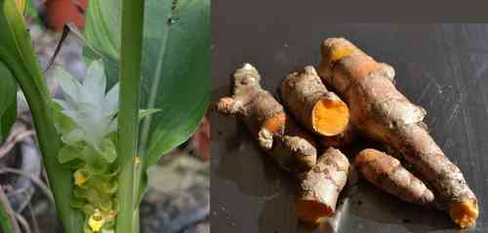
Curcuma longa
Common name: Turmeric
Family: Zingiberaceae
Parts used: Rhizome

Slide 41
Constituents:
Flavonoids, volatile oil (zingiberene, tumerone), Curcuminoids (Curcumin), bitter principle, resins, proteins, nutrients,
Medicinal actions:
Anti-inflammatory, antioxidant, anti-cancer, anti-microbial, antibiotic, astringent, circulatory stimulant, choleretic, anthelmintic, hypolipidemic, anti-platelet aggregating, carminative, alterative, hepatoprotector

Slide 42
Medicinal use:
Used internally for liver and digestive complaints, dysmenorrhea, jaundice, and as an anti-inflammatory agent. Is cytotoxic and may be used to prevent and to treat cancer. As an anti-inflammatory agent, can be useful for arthritic conditions, bursitis & pain in general.
Will promote liver function and bile production & flow as will protect the liver from toxic agents. Turmeric is also a useful digestive aid to relieve flatulence and to protect the stomach mucosa against ulceration.

Slide 43
Pharmacology:
Volatile oils (zingiberene & tumerone) are anti-inflammatory and choleretic
Curcumin is primarily lipophilic and has anti-inflammatory and antioxidant effects greater than those of hydrocortisone. Exerts its anti-inflammatory actions topically via the mechanisms mentioned above with additional counter-irritant activity which will deplete nerve endings of substance P (neurotransmitter of pain).

Slide 44
It can protect DNA against single strand breaks induced by single oxygen. When administered orally, curcumin inhibits neutrophil function, inhibits platelet aggregation, inhibits lymphocyte activity, promotes fibrinolysis, & stabilizes lysosomal membranes.

Slide 45
Curcumin interferes with intestinal cholesterol-uptake by increasing the conversion of cholesterol into bile acids via: stimulation of hepatic cholesterol-7-alpha-hydroxylase & through increased bile acid secretion. Inhibits platelet aggregation by inhibiting the formation of thromboxanes (promotes aggregation) & increasing prostacylin (inhibits aggregation).

Slide 46
Pharmacy: Dried turmeric root: 1.5 – 3g QD. Curcumin: 250-300 mg TID; for acute inflammation: 400-600 mg TID (equivalent to 8-60 g of turmeric). Poultice: apply as needed. Tincture: (1:1, 45%), 5-14 ml QD.
Note: Curcumin is not well absorbed orally (40%-85% is absorbed) and taking equal amounts of bromelain with it or taking the curcumin in a lipid base will possibly enhance its absorption.

Slide 47
Toxicity: There have been no reports of toxicity at standard dosage levels. Possible sensitization problems exist for high concentration tumerone (skin rash/photosensitivity).
Contraindications: Caution with biliary obstruction, gallstones or stomach hyperacidity/stomach ulcer.
Interactions: None known.

Slide 48
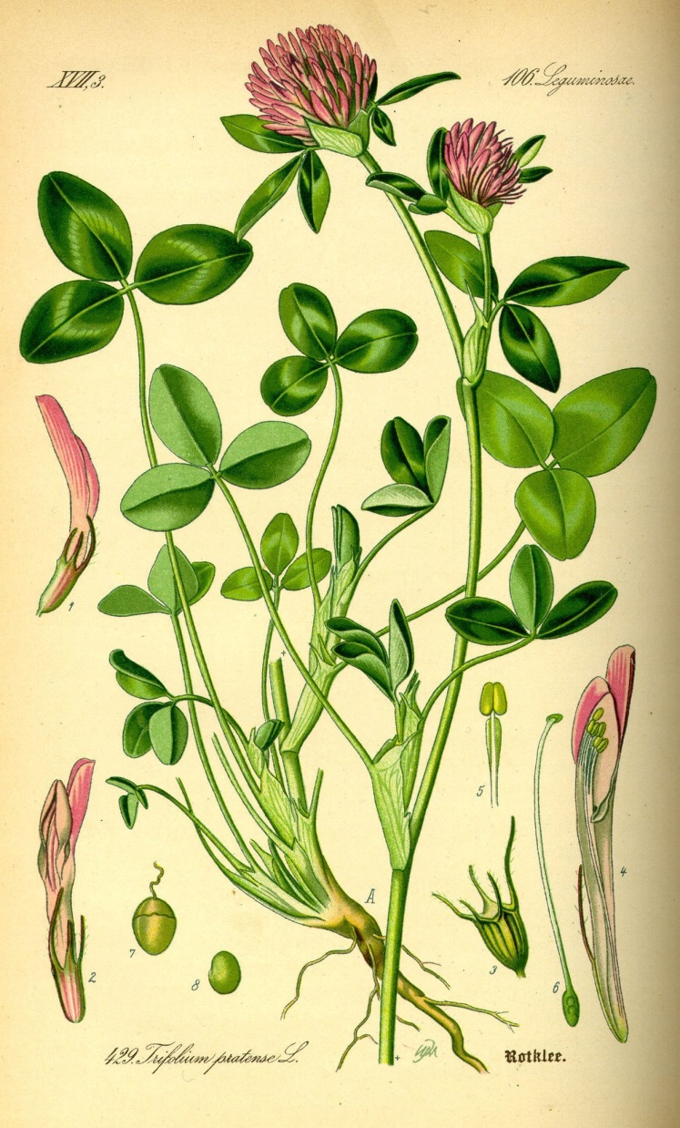
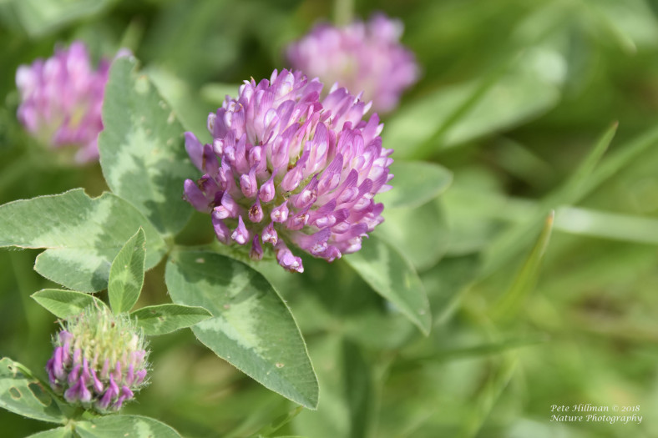
Trifolium pratense
Common name: Red clover
Family: Leguminosae
Parts used: Flowers

Slide 49
Constituents:
Isoflavones, flavonoids, phenolic glycosides, coumarins, cyanogenic glycosides, minerals
Medicinal actions:
Alterative, antispasmodic, expectorant, sedative, phytoestrogenic, nutritive

Slide 50
Medicinal use:
Trifolium is useful for any chronic condition of toxicity, enhances the detoxification functions of the liver.The alterative properties of Trifolium give this herb great usefulness in the treatment of skin conditions. It is of value in recurrent boils or acne, eczema, and psoriasis. Trifolium exerts some of the strongest phytoestrogenic effects among medicinal plants. Valuable for menopausal women because of its phyotoestrogenic and mineral constituents
Pharmacy: Infusion: 2-4 g/cup water TID. Tincture: (1:5), 2-5 ml TID. Fluid extract: 1-2 ml TID.

Slide 51
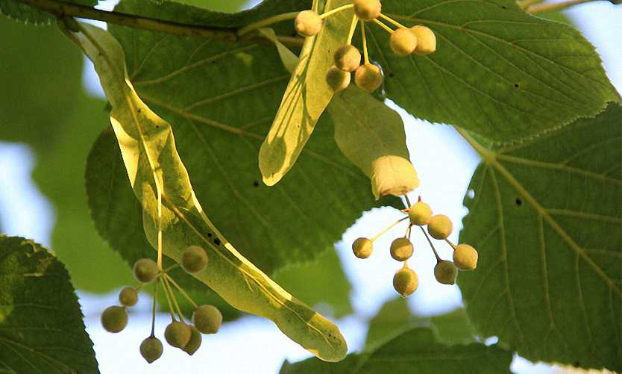
Tilia europea
Common name: Lime flower, Linden tree
Family: Tiliaceae
Parts used: Flowers & leaves

Slide 52
Constituents:
Flavonoids (hespiridin, kaempferol, quercetin), phenolic acids (chlorogenic, caffeic and coumaric), volatile oils (farnesol, eugenol, citral, citronellal, citronellol, limonene, pinene)), mucilage (arabino-galactans), tannin.
Medicinal actions:
Anxiolytic, hypotensive, sedative, diaphoretic, anti-spasmodic, immunomodulator, anti-inflammatory, mild astringent, expectorant, hypotensive, peripheral vasodilator, anti-coagulant, digestive, diuretic, emollient

Slide 53
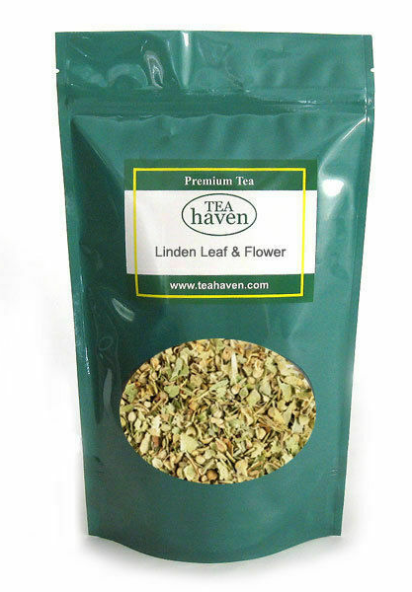
Medicinal use:
Indicated in nervous dyspepsia, hysterical states, headaches, and palpitations. It is hypotensive, although it is rarely strong enough on its own to reduce blood pressure, it will reduce hypertension when associated with arteriosclerosis and nervous tension. Tilia is also a notable diaphoretic and is often used in colds and flu.

Slide 54
Pharmacology:
Volatile oils are diuretic, sedative and antispasmodic.
Flavonoids are antispasmodic and diaphoretic.
Coumaric acid is antispasmodic and diaphoretic.
Pharmacy: Infusion: 1tsp/cup, 3-5 times QD. Tincture: (1:5, 40%), 3-5ml TID. Dried flowers: 2-4g, TID.
Toxicity: None reported. Long-term high doses may be cardiotoxic.
Contraindications: None known.
Interactions: None reported

Slide 55
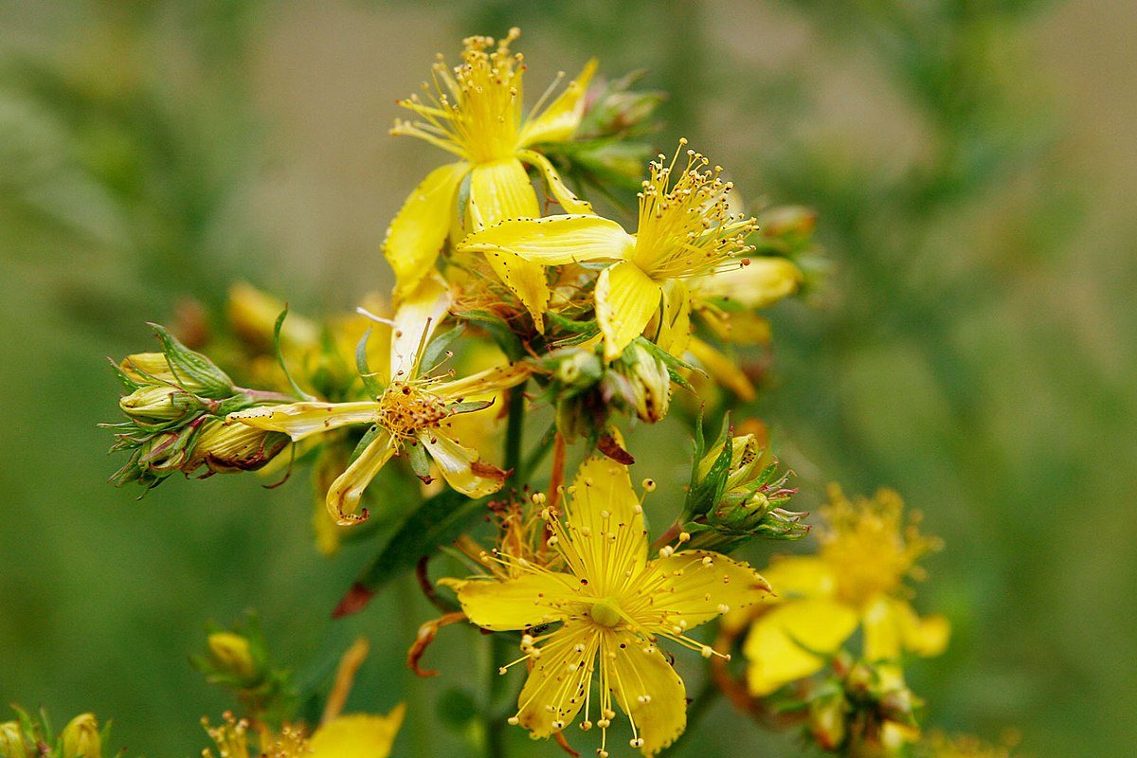
Hypericum perforatum
Common name: St. John’s wort
Family: Hypericaceae
Parts used: Flowering tops

Slide 56
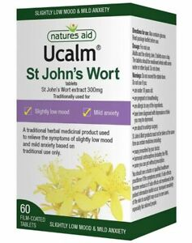
Constituents:
Volatile oils (pinene & cineole)
Flavonoids & proanthocyanidins (hyperoside, hyperiforin, quercetin, rutin)
Naphthodianthrones (hypericin, pseudohypericin, isohypericin, protohypericin)
Carotenoids
Phloroglucins (hyperforin)
Tannins

Slide 57
Medicinal actions:
Anti-depressant
Anti-inflammatory
Antimicrobial
Astringent
Nervine tonic
Vulnerary
Medicinal uses:
Most useful in mild to moderate depression, seasonal affective disorder, anxiety and various somatoform disorders (neuralgia & myalgias).
Is antiviral both internally and topically.
Vulnerary actions make it a wonderful choice for topical wound healing (eg. burns).

Slide 58
Pharmacology:
Naphthodianthrones hypericin & pseudohypericin have received most of the attention in pharmacological studies based on their contributions to the antiviral properties of the plant as well as speculation (based on early in vitro data) that they may also contribute to the plant’s antidepressant actions.
Hyperforin has been shown to have antimicrobial activity against gram-positive bacteria and numerous viruses.
Hypericin is a powerful photosensitizer and has anti-tumor actions. Once taken up by tumor cells, hypericin reacts in the presence of oxygen and activates multiple apoptosis pathways that results in malignant cell death

Slide 59
Pharmacy:
Infusion: 2-4 g / cup QD to TID
Tincture (1:5, 40%), 1-4 ml TID
Standardized extract: 500 to 1000 mg divided daily of extract standardized to 0.3% hypericin for mild-moderate depression.
Note: May take 2-4 weeks to notice clinical results.

Slide 60
Toxicity:
Photosensitivity can occur in susceptible individuals. Fair-skinned individuals should take precautions when exposed to the sun, and It is advisable that the elderly use protective eyewear when exposed also.
Reported side effects include gastrointestinal irritations, allergic skin reactions, tiredness and restlessness.
Contraindications:
Speeds up the elimination of many drugs through phase liver detoxification and can interfere with narcotics & reserpine

Slide 61
Interactions:
Concomitant use with selective serotonin reuptake inhibitors (SSRIs) may result in serotonin syndrome.
Affects the hepatic metabolism of the cholesterol-lowering drugs simvastatin and pravastatin, omeprazole (a proton pump inhibitor) and oral contraceptives.

Slide 62
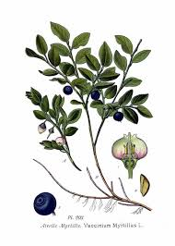
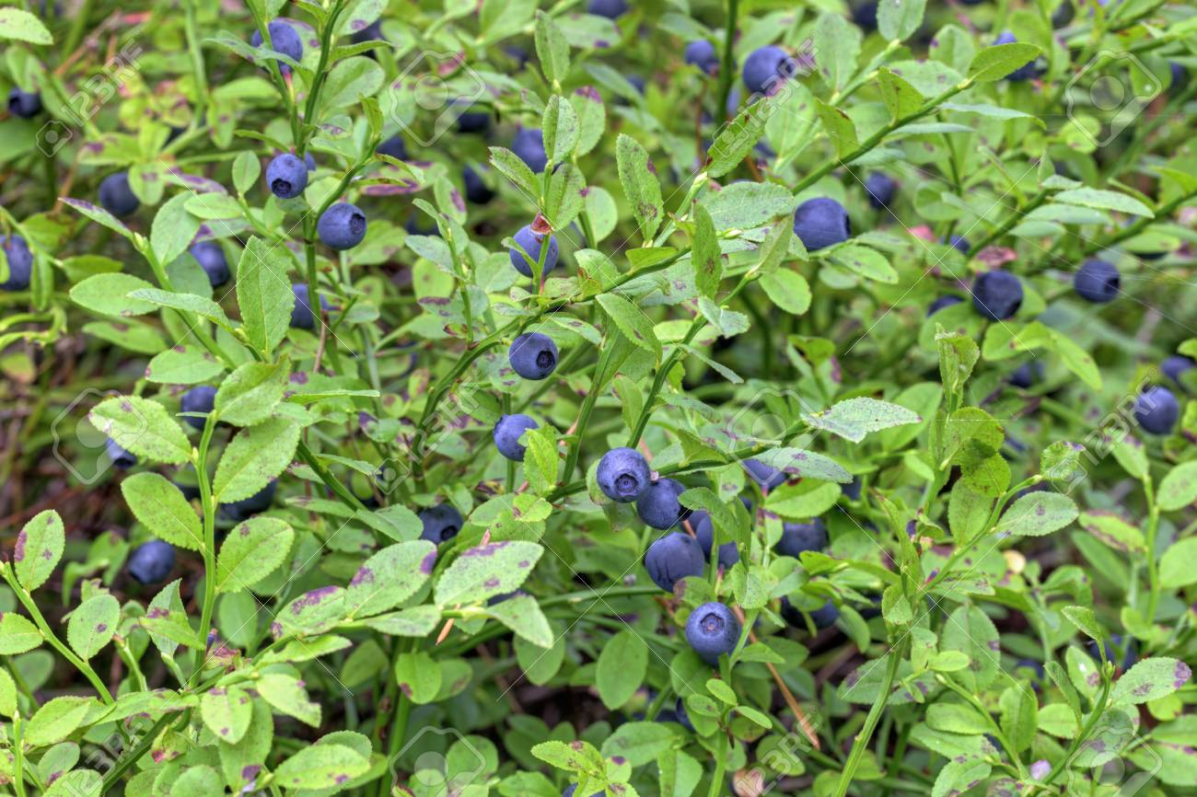
Vaccinium myrtillus
Common name: Blueberry, Bilberry
Family: Ericaceae
Part used: Berry/fruit, leaf

Slide 63
Constituents: Flavonoids: anthocyanosides, tannin (7%), polyphenols (catechin, epicatechin), nutrients (Vitamin B1, C, beta carotene), pectin
Medical actions: Anti-inflammatory, astringent, diuretic, antioxidant, anti-microbial, anti-edematous, venous tonic, vaso-protector, anti-platelet, anti-emetic, anti-diarrheal

Slide 64
Medical uses:
Is indicated in visual disturbances/poor vision, retinopathy, cataracts and macular degeneration, as well as retinitis pigmentosa, diabetic retinopathy, and night-blindness. Used in the prevention and treatment of glaucoma.The antioxidant effects make Vaccinium useful in gout and rheumatoid arthritis. It is useful for venous insufficiency (especially in the legs), hemorrhoids, varicose veins and capillary fragility as a whole.

Slide 65
Bilberries have been used as food and for their high nutritive value. Medicinally, they have been utilized in the treatment of scurvy and urinary complaints (including infection and stones). The dried berries have been used primarily for their astringent qualities. in the treatment of diarrhea and dysentery. Decoctions of the leaves have been used in the treatment of diabetes.

Slide 66
Pharmacology:
Anthocyanins are antioxidant and blood vessel tonics which help to stabilize collagen and protect it during inflammation.
Over 15 different anthocyanosides originate from the five different anthocyanidins found in bilberry.
Pharmacy:
Standardized extract (25% anthocyanosides): 80-160 mg TID. Fresh berries: 2-4 oz. TID. Decoction, as a mouthwash or tea: simmer 3 tbsp in ½ Liter of water for 10 min, drink throughout the day. Tincture: (1:1, 25%), 3-6ml QD.

Slide 67
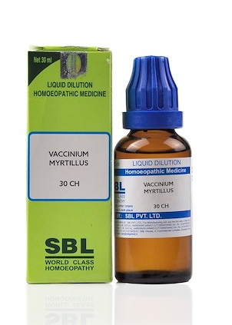
Contraindications: Caution in hemorrhagic disorders.
Toxicity: None reported.
Interactions: Anti-coagulant medication (theoretical).

